Slide 1
Welcome to the labs!
Password Cracker

Slide 2
Who are the tutors?

Slide 3
Who are you?

Slide 4








People Bingo
Rules: 1) Read each square. 2) Find a new friend who can complete any of the squares. 3) One friend can fill in one square only. 4) The first person to fill in every square wins!
Can fluently speak more than one language 🗣 | Has been to GPN before 💚 | Has visited another country ✈️ | Can play chess ♟ | Has more than 1 pet 🐶
Favourite food is Pizza 🍕 | Knows what a Kumquat is ❓ | Has made their own pasta 🍝 | Has eaten Dragon fruit 🐲 | Was born in another country 🌎
Knows how to Juggle 🤹‍♀️ | Likes to play Tetris 🎮 | Is an only child 👨‍👩‍👧 | Likes to paint 🎨 | Knows a magic trick 🪄
Plays an instrument 🎶 | Can ride a skateboard 🛹 | Likes to read 📖 | Has the same favourite colour as you 🌈 | Has the same eye colour as you 👀
Has a part time or casual job 💰 | Is in the same school year as you 🚌 | Knows the second verse of the national anthem 🇦🇺 | Has created their own coding project 💻 | Plays sport on the weekend ⚽️

Slide 5
Tell us you’re here!
Click on the
Start of Day Survey
and fill it in now!

Slide 6

Today’s project!
Password Cracker!

Slide 7

Using the workbook!
The workbooks will help you put your project together!
Each Part of the workbook is made of tasks!
Tasks - The parts of your project
Follow the tasks in order to make the project!
Task 6.2: Add a blah to your code!
This has instructions on how to do a part of the project Start by doing this part Then you can do this part
Hints - Helpers for your tasks!
Stuck on a task, we might have given you a hint to help you figure it out! The hints have unrelated examples, or tips. Don’t copy and paste in the code, you’ll end up with something CRAZY!
Task 6.1: Make the thing do blah!
Make your project do blah ….
Hint
A clue, an example or some extra information to help you figure out the answer.
print('This example is not part of the project’)

Slide 8

Using the workbook!
The workbooks will help you put your project together!
Check off before you move on from a Part! Do some bonuses while you wait!
Checklist - Am I done yet?
Make sure you can tick off every box in this section before you go to the next Part.
CHECKPOINT
If you can tick all of these off you’re ready to move the next part! ☐ Your program does blah ☐ Your program does blob
Lecture Markers
This tells you you’ll find out how to do things for this section during the names lecture.
Bonus Activities
Stuck waiting at a lecture marker?
Try a purple bonus. They add extra functionality to your project along the way.
★ BONUS 4.3: Do some extra!
Something to try if you have spare time before the next lecture!

Slide 9
Intro to Programming

Slide 10
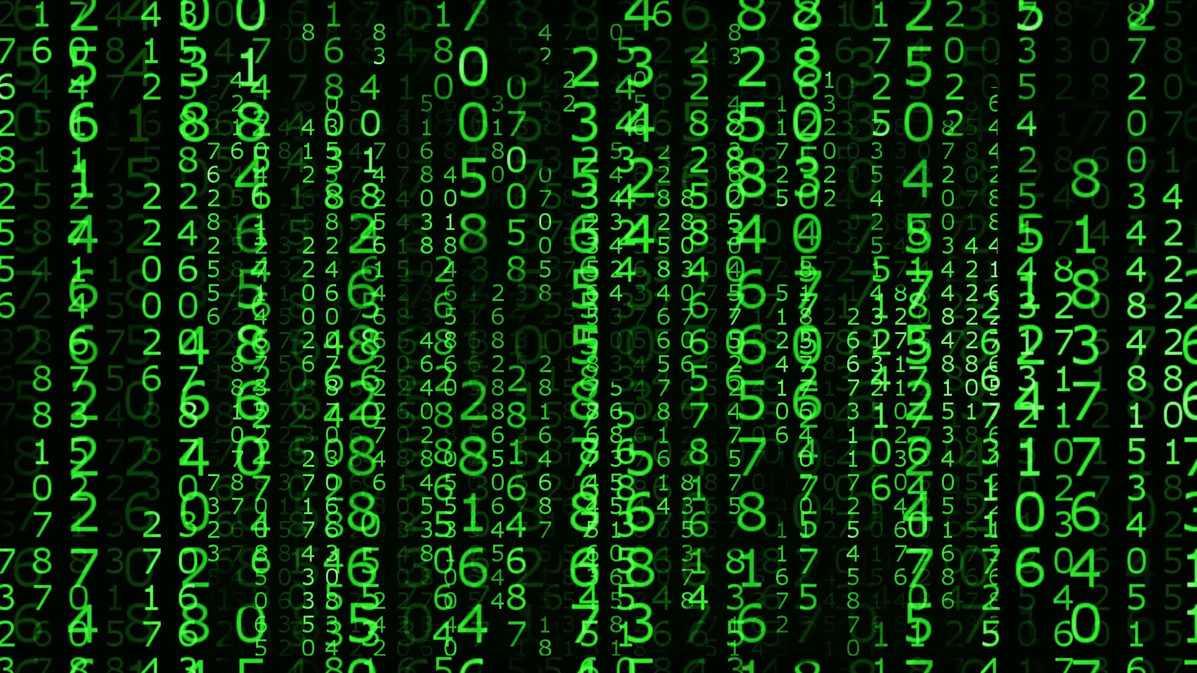

What is programming?
Programming is not a bunch of crazy numbers!
It’s giving computers a set of instructions!

Slide 11
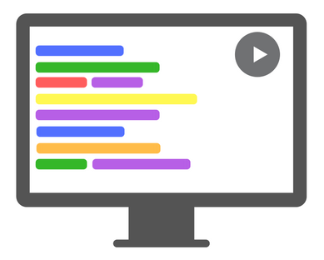
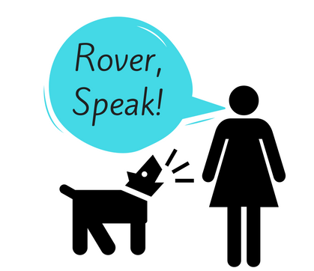
A Special Language
A language to talk to dogs!
Programming is a language to talk to computers
Notes:
Today we’ll be learning python. One of many langauges people developed to give computers instructions

Slide 12
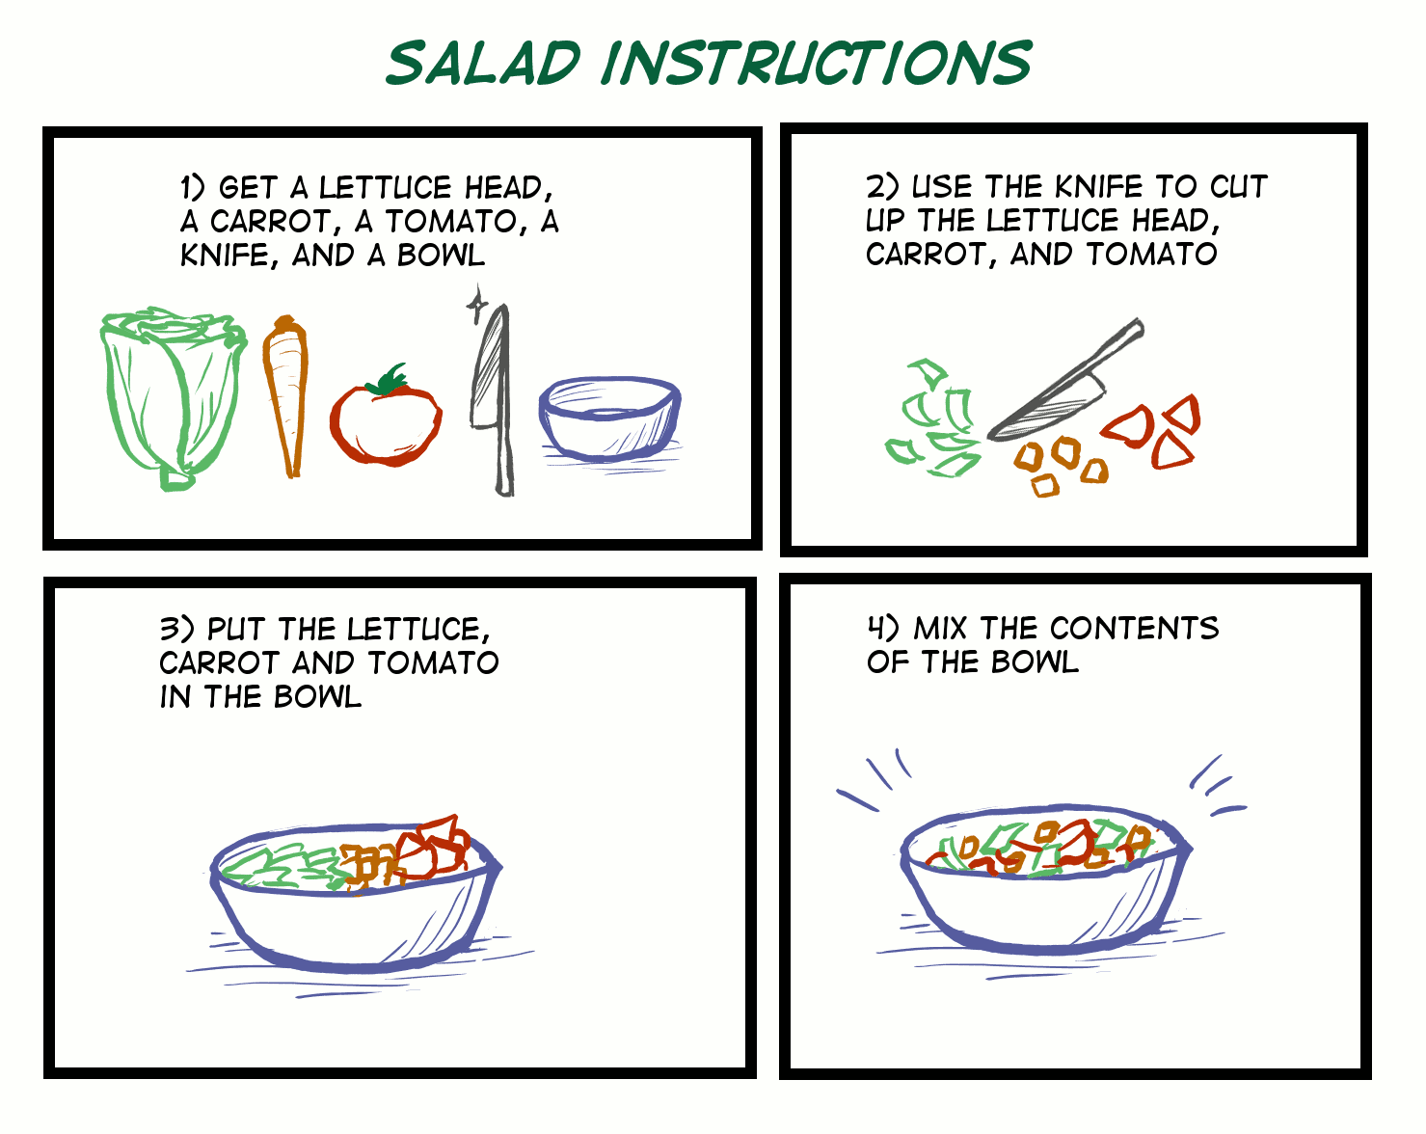
People are smart! Computers are dumb!
Programming is like a recipe!
Computers do EXACTLY what you say, every time.
Which is great if you give them a good recipe!
Notes:
Programming is like a recipe, a set of instructions for getting something done Computers read instructions from top to bottom, even if they don't make sense that way!
If the steps are in order, you get a nice meal....

Slide 13
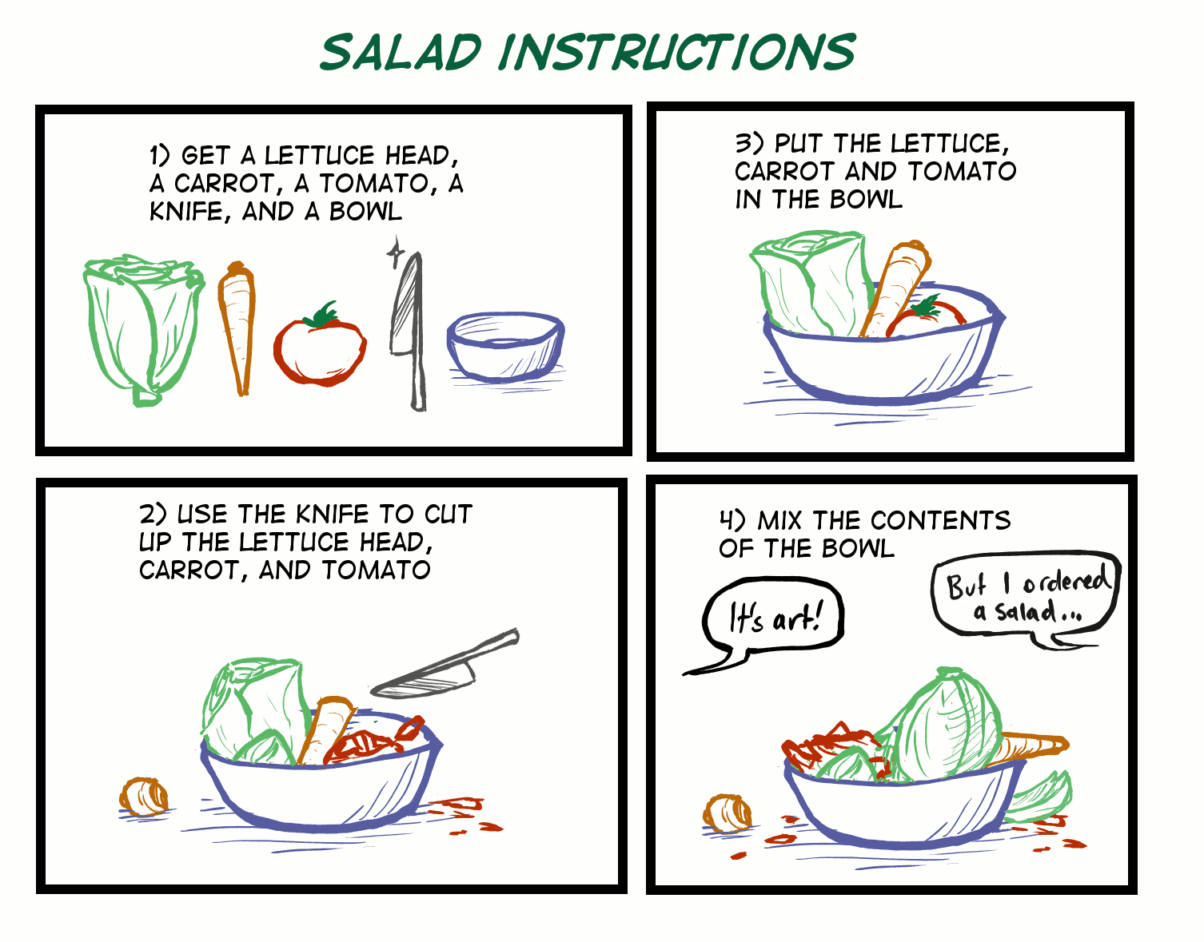
People are smart! Computers are dumb!
But if you get it out of order…. A computer wouldn’t know this recipe was wrong!

Slide 14
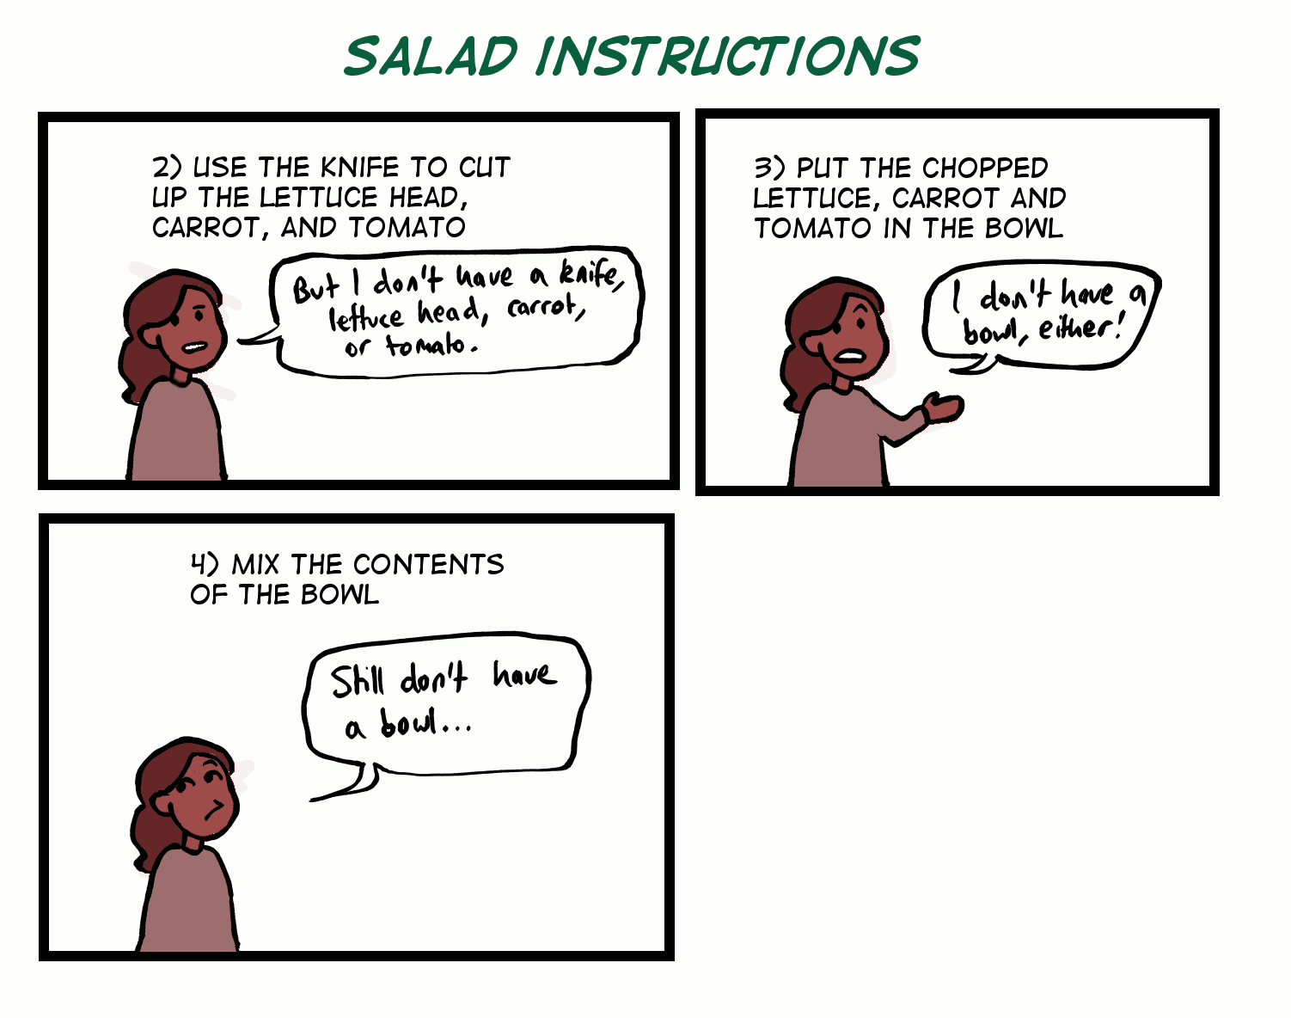
People are smart! Computers are dumb!
Computers are bad at filling in the gaps! A computer wouldn’t know something was missing, it would just freak out!
Notes:
Programming is like a recipe, a set of instructions for getting something done Computers read instructions from top to bottom, even if they don't make sense that way!
If the steps are in order, you get a nice meal....

Slide 15
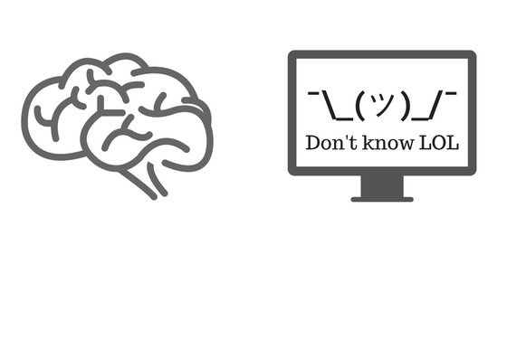
Everyone/thing has strengths!
Understand instructions despite:
Spelling mistakes
Typos
Confusing parts
Solve problems
Tell computers what to do
Get smarter every day
Does exactly what you tell it
Does it the same every time
Doesn’t need to sleep!
Will work for hours on end!
Get smarter when you tell them how

Slide 16
Intro to Python
Let’s get coding!

Slide 17

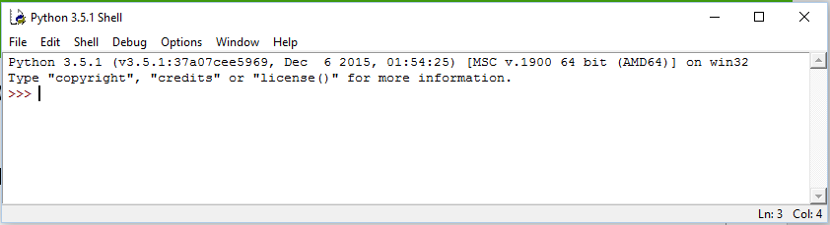
Where do we program? In IDLE
Click the start button and type IDLE!
You should get something like this!

Slide 18
Make a mistake!
Type by button mashing the keyboard!
Then press enter!
asdf asdjlkj;pa j;k4uroei
Did you get a big red error message?

Slide 19

Mistakes are great!
ImportError: No module named humour
Good work you made an error!
Programmers make A LOT of errors!
Errors give us hints to find mistakes
Run your code often to get the hints!!
Mistakes won’t break computers!
SyntaxError: Invalid Syntax
KeyError: ‘Hairy Potter’
TypeError: Can't convert 'int' object to str implicitly
AttributeError: 'NoneType' object has no attribute 'foo'

Slide 20
Write some code!!
Type this into the window
Then press enter! print('hello world')
Did it print:
hello world
???

Slide 21

No Storing is Boring!
It’s useful to be able to remember things for later!
Computers remember things in "variables"
8
Variables are like putting things into a labeled cardboard box.
Let’s make our favourite number 8 today!
fav_num

Slide 22
Variables
Instead of writing the number 8, we can write fav_num.
fav_num
fav_num - 6
=> _
fav_num * 2
=> __
fav_num + 21
=> __
fav_num / 2
=> _

Slide 23
Variables
Instead of writing the number 8, we can write fav_num.
fav_num
fav_num - 6
=> 2
fav_num * 2
=> __
fav_num + 21
=> __
fav_num / 2
=> _

Slide 24
Variables
Instead of writing the number 8, we can write fav_num.
fav_num
fav_num - 6
=> 2
fav_num * 2
=> __
fav_num + 21
=> 29
fav_num / 2
=> _

Slide 25
Variables
Instead of writing the number 8, we can write fav_num.
fav_num
fav_num - 6
=> 2
fav_num * 2
=> 16
fav_num + 21
=> 29
fav_num / 2
=> _

Slide 26
Variables
Instead of writing the number 8, we can write fav_num.
fav_num
fav_num - 6
=> 2
fav_num * 2
=> 16
fav_num + 21
=> 29
fav_num / 2
=> 4

Slide 27

Variables
Instead of writing the number 8, we can write fav_num.
fav_num
fav_num - 6
=> 2
fav_num * 2
=> 16
fav_num + 21
=> 29
fav_num / 2
=> 4
But writing 8 is much shorter than writing fav_num???

Slide 28
Variables
102
Variables are useful for storing things that change
(i.e. things that "vary" - hence the word "variable")
Try changing fav_num to 102.
fav_num

Slide 29
Variables
We're able to use our code for a new purpose, without rewriting everything:
fav_num
fav_num - 6
=> __
fav_num * 2?
=> ___
fav_num + 21
=> ___
fav_num / 2?
=> __

Slide 30
Variables
We're able to use our code for a new purpose, without rewriting everything:
fav_num
fav_num - 6
=> 96
fav_num * 2?
=> ___
fav_num + 21
=> ___
fav_num / 2?
=> __

Slide 31
Variables
We're able to use our code for a new purpose, without rewriting everything:
fav_num
fav_num - 6
=> 96
fav_num * 2?
=> ___
fav_num + 21
=> 123
fav_num / 2?
=> __

Slide 32
Variables
We're able to use our code for a new purpose, without rewriting everything:
fav_num
fav_num - 6
=> 96
fav_num * 2?
=> 204
fav_num + 21
=> 123
fav_num / 2?
=> __

Slide 33
Variables
We're able to use our code for a new purpose, without rewriting everything:
fav_num
fav_num - 6
=> 96
fav_num * 2?
=> 204
fav_num + 21
=> 123
fav_num / 2?
=> 51

Slide 34
No variables VS using variables
4 Changes
1 Change
fav_num
fav_num
8 - 6
8 * 2
8 + 21
8 / 2
102 - 6
102 * 2
102 + 21
102 / 2
int fav_num = 8
fav_num - 6
fav_num * 2
fav_num + 21
fav_num / 2
int fav_num = 102
fav_num - 6
fav_num * 2
fav_num + 21
fav_num / 2

Slide 35
Asking a question!
It’s more fun when we get to interact with the computer! Let’s learn about input!
>>> my_name = input('What is your name? ')
>>> print(‘Hello ’ + my_name)

Slide 36
How input works!
Writing input tells the computer to wait for a response
This is the question you want printed to the screen
Store the answer in the variable my_name
>>> my_name = input('What is your name? ')
>>> print(‘Hello ’ + my_name)
We use the answer that was stored in the variable later!

Slide 37
Adding a comment!
Sometimes we want to write things in our file that the computer doesn’t look at! We can use "Comments" for that! Sometimes we want to write a note for people to read
And sometimes we want to not run some code (but don’t want to delete it!)
# This code was written by Vivian
# print("Goodbye world!")

Slide 38
Project time!
Now you can give the computer variables!
Let’s put what we learnt into our project
Try to do Part 0 - 1
The tutors will be around to help!

Slide 39
If Statements

Slide 40

Conditions!
Conditions let us make decision.
First we test if the condition is met!
Then maybe we’ll do the thing
If it’s raining take an umbrella
Yep it’s raining
…... take an umbrella

Slide 41
Booleans (True and False)
Computers store whether a condition is met in the form of True and False
To figure out if something is True or False we do a comparison
What do you think these are? True or False?
5 < 10
3 + 2 == 5
5 != 5
"Dog" == "dog"
"D" in "Dog"
"Q" not in "Cat"

Slide 42
Booleans (True and False)
Computers store whether a condition is met in the form of True and False
To figure out if something is True or False we do a comparison
What do you think these are? True or False?
5 < 10
3 + 2 == 5
5 != 5
"Dog" == "dog"
"D" in "Dog"
"Q" not in "Cat"
True

Slide 43
Booleans (True and False)
Computers store whether a condition is met in the form of True and False
To figure out if something is True or False we do a comparison
What do you think these are? True or False?
5 < 10
3 + 2 == 5
5 != 5
"Dog" == "dog"
"D" in "Dog"
"Q" not in "Cat"
True
True

Slide 44
Booleans (True and False)
Computers store whether a condition is met in the form of True and False
To figure out if something is True or False we do a comparison
What do you think these are? True or False?
5 < 10
3 + 2 == 5
5 != 5
"Dog" == "dog"
"D" in "Dog"
"Q" not in "Cat"
True
True
False

Slide 45
Booleans (True and False)
Computers store whether a condition is met in the form of True and False
To figure out if something is True or False we do a comparison
What do you think these are? True or False?
5 < 10
3 + 2 == 5
5 != 5
"Dog" == "dog"
"D" in "Dog"
"Q" not in "Cat"
True
False
True
False

Slide 46
Booleans (True and False)
Computers store whether a condition is met in the form of True and False
To figure out if something is True or False we do a comparison
What do you think these are? True or False?
5 < 10
3 + 2 == 5
5 != 5
"Dog" == "dog"
"D" in "Dog"
"Q" not in "Cat"
True
False
True
True
False

Slide 47
Booleans (True and False)
Computers store whether a condition is met in the form of True and False
To figure out if something is True or False we do a comparison
What do you think these are? True or False?
5 < 10
3 + 2 == 5
5 != 5
"Dog" == "dog"
"D" in "Dog"
"Q" not in "Cat"
True
False
True
True
False
True

Slide 48
Conditions
So to know whether to do something, they find out if it’s True!
fave_num = 5
if fave_num < 10:
print("that’s a small number")

Slide 49
Conditions
So to know whether to do something, they find out if it’s True!
fave_num = 5
if fave_num < 10:
print("that’s a small number")
That’s the condition!

Slide 50
Conditions
So to know whether to do something, they find out if it’s True!
fave_num = 5
if fave_num < 10:
print("that’s a small number")
That’s the condition!
Is it True that fave_num is less than 10?
Well, fave_num is 5
And it’s True that 5 is less than 10
So it is True!

Slide 51
Conditions
So to know whether to do something, they find out if it’s True!
fave_num = 5
if fave_num < 10:
print("that’s a small number")
True
Put in the answer to the question
Is it True that fave_num is less than 10?
Well, fave_num is 5
And it’s True that 5 is less than 10
So it is True!

Slide 52
Conditions
So to know whether to do something, they find out if it’s True!
fave_num = 5
if fave_num < 10:
print("that’s a small number")
True
What do you think happens?

Slide 53
Conditions
So to know whether to do something, they find out if it’s True!
fave_num = 5
if fave_num < 10:
print("that’s a small number")
True
What do you think happens? >>> that’s a small number

Slide 54
Conditions
How about a different number???
fave_num = 9000
if fave_num < 10:
print("that’s a small number")

Slide 55
Conditions
It’s False!
fave_num = 9000
if fave_num < 10:
print("that’s a small number")
False
Put in the answer to the question

Slide 56
Conditions
It’s False!
fave_num = 9000
if fave_num < 10:
print("that’s a small number")
False
What do you think happens? >>>

Slide 57
Conditions
fave_num = 9000
if fave_num < 10:
print("that’s a small number")
False
Nothing!
What do you think happens? >>>

Slide 58
If statements
fave_num = 5
if fave_num < 10:
print("that’s a small number")
This line …
… controls this line

Slide 59
If statements
Actually …..
fave_num = 5
if fave_num < 10:
print("that’s a small number")
print("and I like that")
print("A LOT!!")
This line …
… controls anything below it that is indented like this!

Slide 60
If statements
What do you think happens?
fave_num = 5
if fave_num < 10:
print("that’s a small number")
print("and I like that")
print("A LOT!!")
What do you think happens?

Slide 61
If statements
What do you think happens?
fave_num = 5
if fave_num < 10:
print("that’s a small number")
print("and I like that")
print("A LOT!!")
>>> that’s a small number >>> and I like that >>> A LOT!!

Slide 62
If statements
word = "GPN"
if word == "GPN":
print("GPN is awesome!")
What happens??

Slide 63
If statements
word = "GPN"
if word == "GPN":
print("GPN is awesome!")
What happens??
>>> GPN is awesome!

Slide 64
Else statements
word = "GPN"
if word == "GPN":
print("GPN is awesome!")
But what if we want something different to happen if the word isn’t "GPN"
What happens??
>>> GPN is awesome!

Slide 65
Else statements
else
statements means something still happens if the if statement was False
word = "Chocolate"
if word == "GPN":
print("GPN is awesome!")
else:
print("The word isn’t GPN :(")
What happens??

Slide 66
Else statements
else
statements means something still happens if the if statement was False
word = "Chocolate"
if word == "GPN":
print("GPN is awesome!")
else:
print("The word isn’t GPN :(")
What happens??
>>> The word isn’t GPN :(

Slide 67
Project Time!
You now know all about if and else!
Let’s put what we learnt into our project
Try to do Part 2
The tutors will be around to help!

Slide 68
Hashing

Slide 69
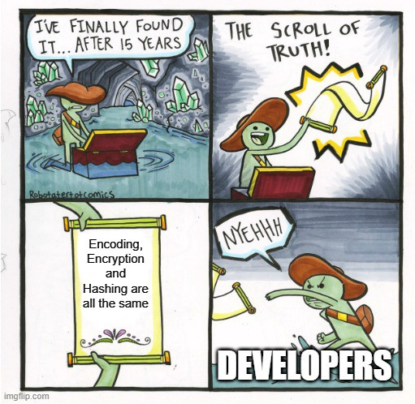
Encoding!
Now before we actually start hashing, we need to learn about the concept encoding.
Have you heard of it before? Any guesses on how this might be different from hashing?
https://medium.com/swlh/the-difference-between-encoding-encryption-and-hashing-878c606a7aff#:~:text=%2D%20Encoding%20is%20a%20process%20of,into%20a%20fixed%2Dlength%20string.

Slide 70
What is Encoding?
Encoding is the process of making a word (or character, sentence etc.) readable by a computer.
There are different ways we can store things in a computer, such as utf-8 where the letter `a` is encoded to `01100001` which a computer can understand.
https://medium.com/swlh/the-difference-between-encoding-encryption-and-hashing-878c606a7aff#:~:text=%2D%20Encoding%20is%20a%20process%20of,into%20a%20fixed%2Dlength%20string.

Slide 71
What is Hashing?
Hashing is the process of making a character, word, etc. unreadable by a human, which makes it more secure.
The value that has been hashed is called a hash!

Slide 72
What is Hashing?
How does it work?
We take a readable word or phrase (this is called plaintext) like this:
password
This is a plaintext word that we can read!

Slide 73
What is Hashing?
How does it work?
We take a readable word or phrase (this is called plaintext) like this:
And we use a “Hash function” to turn it into something we can’t read!
password
b'\xcc\xd6R\x16\xb9\x1bP~lK\x01\x0e\x063\x10\xec'
This is a plaintext word that we can read!
This is the Hash Function
This is a hash value that we can’t read!

Slide 74
What is Hashing?
The coolest thing about a Hash function is that you can only go one way, so you can’t work out what the plaintext word was if you only have the hash value - this makes it secure!
x
password
b'\xcc\xd6R\x16\xb9\x1bP~lK\x01\x0e\x063\x10\xec'
This is a plaintext word that we can read!
This is the Hash Function
This is a hash value that we can’t read!

Slide 75
Hashing in Python
Firstly to use the Python code we need to import the hashing library!
We can do this by writing:
import hashlib
at the top of our code!

Slide 76
Encoding
After we have imported our library we can start hashing by first encoding our variables using the .encode() method!
my_string = “hello”
my_string_encoded = my_string.encode()
Encode
8-bit
H
01101000
The computer can read this!

Slide 77
Hashing!
Now we can actually hash our value!
To hash a value we can use the .md5() function like this:
This is the encoded string from the last slide!
my_string_hashed = hashlib.md5(my_string_encoded)
MD5 is the name of the hash function that we are using!

Slide 78
Digest!
After hashing our variable we want to turn it into a value we can use, so we use the .digest() method, written:
my_string_hashed = hashlib.md5(my_string_encoded).digest()
This turns the hash into something that we can use!

Slide 79
Digest!
After hashing our variable we want to turn it into a value we can use, so we use the .digest() method, written:
Result:
b']A@*\xbcK*v\xb9q\x9d\x91\x10\x17\xc5\x92'
my_string_hashed = hashlib.md5(my_string_encoded).digest()

Slide 80
Project Time!
Hashing!
Let’s put what we learnt into our project
Try to do Parts 3 - 5!
The tutors will be around to help!

Slide 81
Extension: Meme Generator

Slide 82
Show me the memes!
We have some accounts for you to try and crack into! They are some accounts for our secret website, the GPN Meme Exchange!
Once you’ve cracked the passwords, head over there and try them out!
https://girls-programming-network.github.io/meme-exchange/
The link is also on the website from the start of the day!

